Slide 1
ATTENDANCE MANAGEMENT SYSTEM USING FACE RECOGNITION
PROJECT GUIDE : Mrs. Suguna T, M.Tech AP/IT
by,
Arun I (1718105)
Rathesh Prabakar (1718131)
Sanjai M (1718134)

Slide 2
INTRODUCTION
It is a web application to make the entire attendance system automated using face recognition.
This system will completely give a big relief to the faculties.
This system will able to download the attendance report and send the notifications at any time.

Slide 3
LITERATURE SURVEY
S.No | Title | Author | Year | Methods | Merits | Demerits
1 | Class Attendance management system using Face Recognition | Omar Abdul Rhman Salim, Rashidah Funke Olanrewaju, Wasiu Adebayo Balogun | 2018 | Local Binary Pattern Algorithm(LBP),Mysql | Easily accessible | Less sensitivity and not effective in darkness.
2 | Automated Attendance system using Image Processing | Smit Hapani, Nandana Prabhu, Nikhil Parakhiya | 2018 | Viola Jones Algorithm,Fisher Face Algorithm | Less proxy | Accuracy <50%

Slide 4
S.No | Title | Author | Year | Methods | Merits | Demerits
3 | Real Time Attendance using Face Recoginition Technique | Mayank Srivastava, Amit kumar, Aditya Dixit, Aman Kumar | 2020 | Open CV,Haar Cascade Algorithm | Accuracy high | Less accuracy in large area
4 | Attendance management system using Face Recognition | Aditya Tyagi, Kundan Kumar, Sumar Kumar Jha | 2020 | Cascade Classifier,LBPH Algorithm | Robust Against monotonic grey | Take more than 5 secs to recognize

Slide 5
S.No | Title | Author | Year | Methods | Merits | Demerits
5 | Student Attendance System using Face Recoginition | Samridhi Dev, Tushar Patnaik | 2020 | KNN,CNN,SVM,Haar Classifier | Cost efficient | Less computational Complexity
6 | Real Time Smart Attendance System using Face Recognition Techniques | Shreyak Sawhney, Karan Kacker | 2019 | PCA,CNN | High Accuracy | Less than 80% accuracy

Slide 6
S.No | Title | Author | Year | Methods | Merits | Demerits
7 | Automatic Attendance Management System using Face Detection | Arjun Raj, Ahammed Shoheb | 2016 | Eigen Faces | Hardware Installation is easy | More Calculation required

Slide 7
PROBLEM STATEMENT:
The existing attendance system requires staffs to manually take the attendance every time.
It is difficult to verify each student in a large classroom environment with distributed branches whether the authenticated students are actually responding or not.
This includes the more time consumed by the staffs to find their name on sheet, sometimes they may mistakenly mark’s another student’s name and sometimes sheet may got lost.

Slide 8
PROPOSED SYSTEM :
By maintaining the attendance manually, the report generation is difficult. This system will reduce the manual work and avoid redundant data. The system can generate weekly, consolidate report based on the attendance.

Slide 9
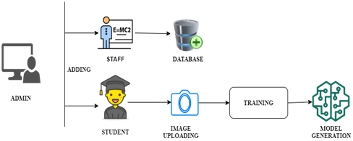
ADMIN MODULE

Slide 10
MODULE :
Admin authorization :
Admin can register the
Faculty Addition
Added the faculty details and store it in the database.
Student Addition
Created training data of each student by entering his roll id and taking snaps of his or her frontal face.
Created model for that particular roll id and save it on Database.

Slide 11
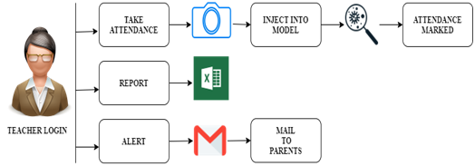
TEACHER’S MODULE

Slide 12
MODULE :
Teacher authorization :
Teacher has to login first
Attendance tab
Snap is taken and it is sent to our model.
Select mark their attendance.
Report tab
Select by date and time, roll id.
View the absent hours of any particular student.
Report generation in Excel format.
Editable and can be able to add ON DUTY.

Slide 13
MODULE :
Teacher authorization (Continue) :
Alert tab
Send email to the students and parents regarding their attendance.
Email alert using flask_mail.

Slide 14
DEPENDENCIES:
DLIB:
dlib is a toolkit for making real world machine learning and data analysis applications in C++.
the library is originally written in C++ and easy to use Python bindings
MYSQL CLIENT:
Mysql Client programs for communicating with the server to manipulate the information in the databases.

Slide 15
FLASK:
flask provides you with tools, libraries and technologies that allow you to build a web application.
FLASK_BOOTSTRAP:
Flask-Bootstrap packages Bootstrap into an extension that mostly consists of a blueprint named 'bootstrap'.

Slide 16
FLASK-MAIL:
The Flask-Mail extension provides a simple interface to set up SMTP with your Flask application and to send messages to clients.

Slide 17
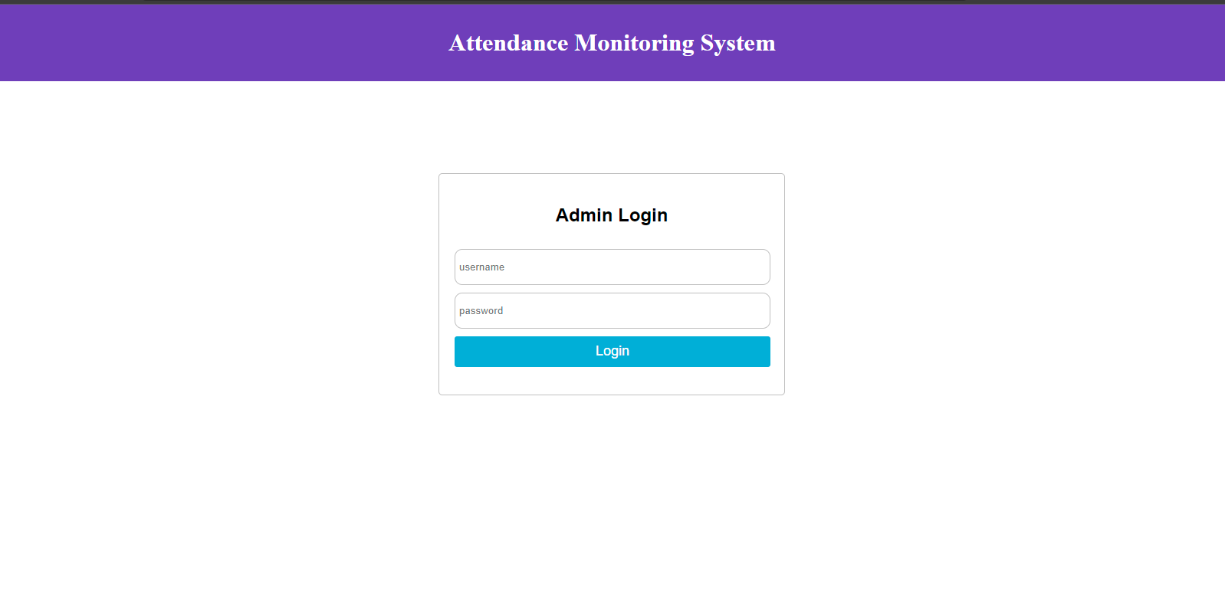
ADMIN PANEL

Slide 18
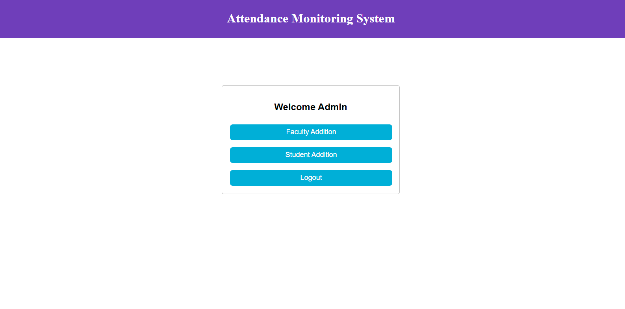
ADMIN FACILITIES

Slide 19
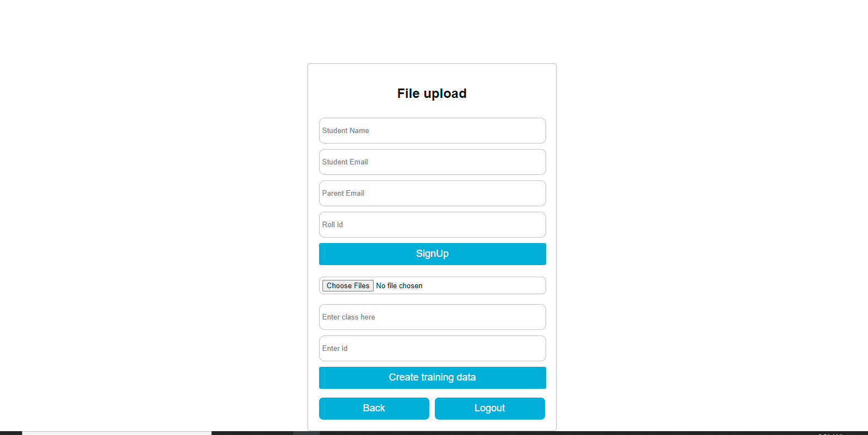
STUDENT ADDITION

Slide 20
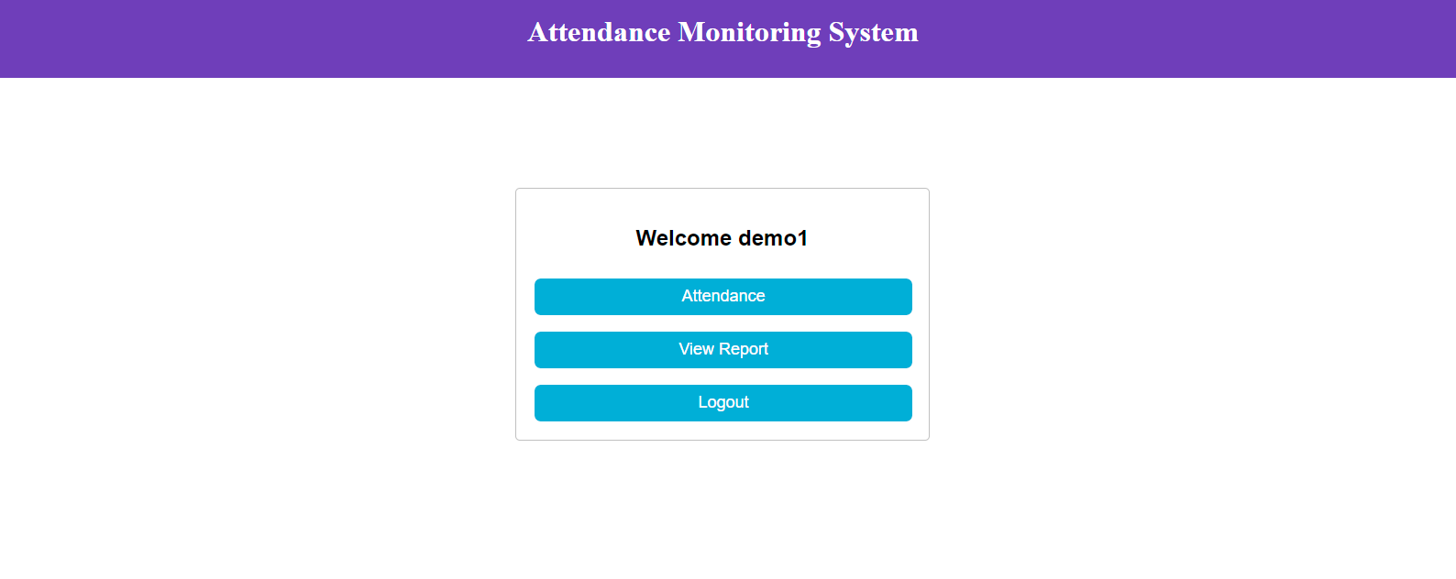
FACULTY DASHBOARD

Slide 21
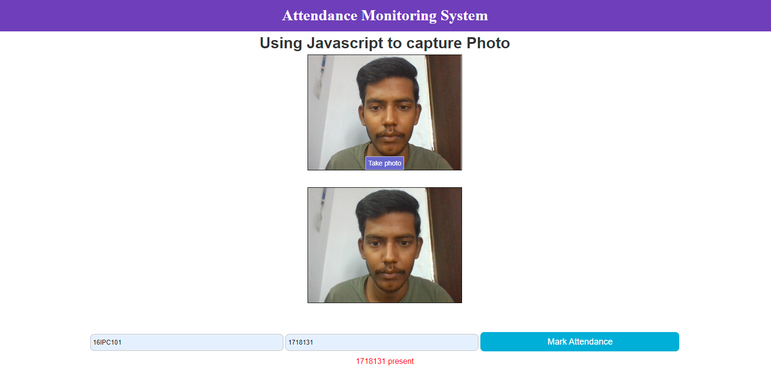
OUTPUT

Slide 22
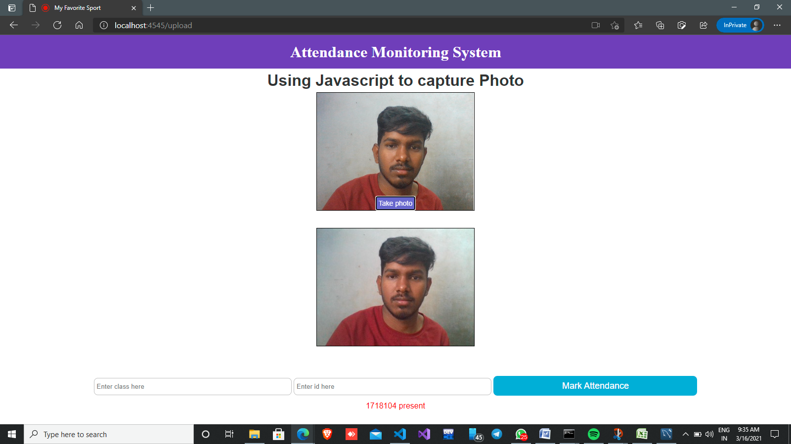

Slide 23
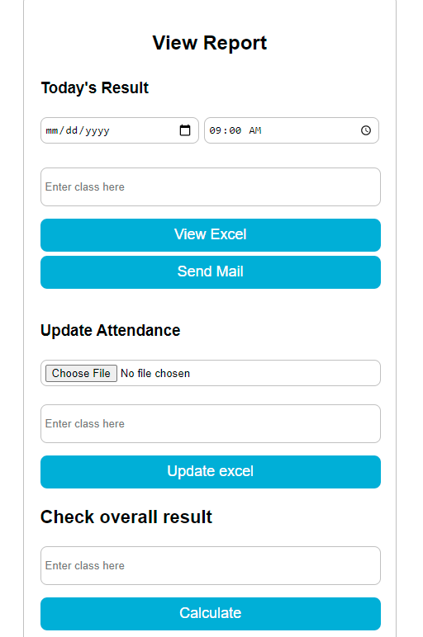
REPORT TAB

Slide 24
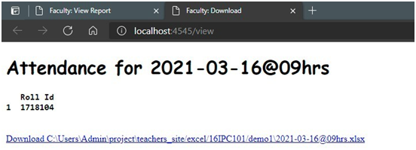
ATTENDANCE VIEW

Slide 25
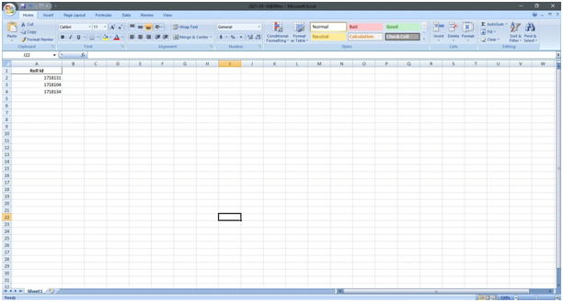
REPORT VIEW

Slide 26
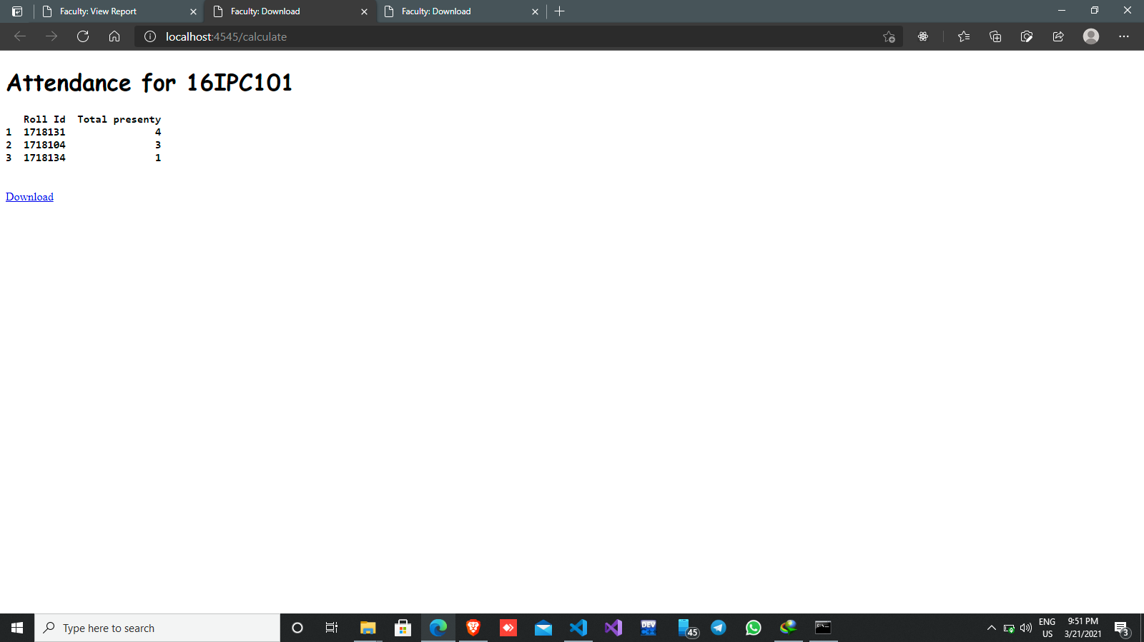
CONSOLIDATED VIEW

Slide 27
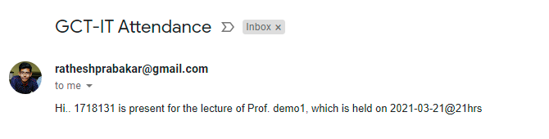
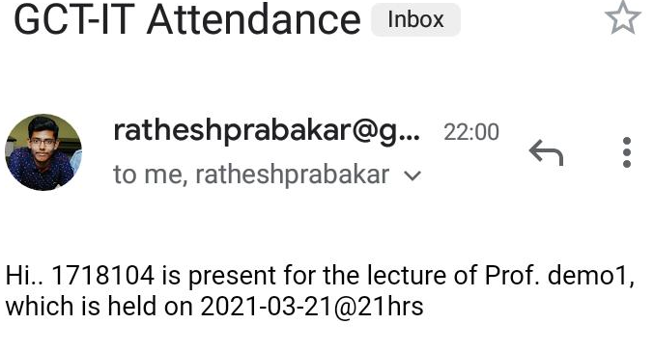
ALERT

Slide 28
SOURCE CODE :
https://github.com/Ratheshprabakar/Attendance-system

Slide 29
CONCLUSION :
This system will be developed using Python and Flask framework fully meets the objectives of the system which it has been developed.
The system will be operated at a high level of efficiency and all the teachers and user associated with the system understands its advantage.

Slide 30
REFERENCES :
[1] Yohei Kawaguchi Tetauo ahoji ,“Face Recognition-based Lecture Attendance System”,”3rd AERU ”,2005.
[2] B.Kavin mathi,S.Hemalatha,”Attendance System for Face Recognition using GSM module”,”4th International Conference on Signal Processing and Integrated Networks”,2018.
[3] Ketan N Mahajan,Nagaraj V,Dharwadkar, “Classroom Attendance System using surveilance camera”,”International Conference On Computer Systems, Electronics and Control”,2017.

Slide 31
[4] E.Varadharajanm,R.Dharani,S.Jeevitha,”Automatic Attendance Management System using Face Detection”,2017.
[5] Chen,Joy long Zong,”Smart Security System for Suspicious Activity Detection in Volatile Areas”.Journal of Information Technology 2,2020.
[6] Mayank Yadav ,Anmol Agarwal,”Motion based Attendance System in real time environment for multimedia application”,2018.
********

Slide 32
THANK YOU

